Slide 1
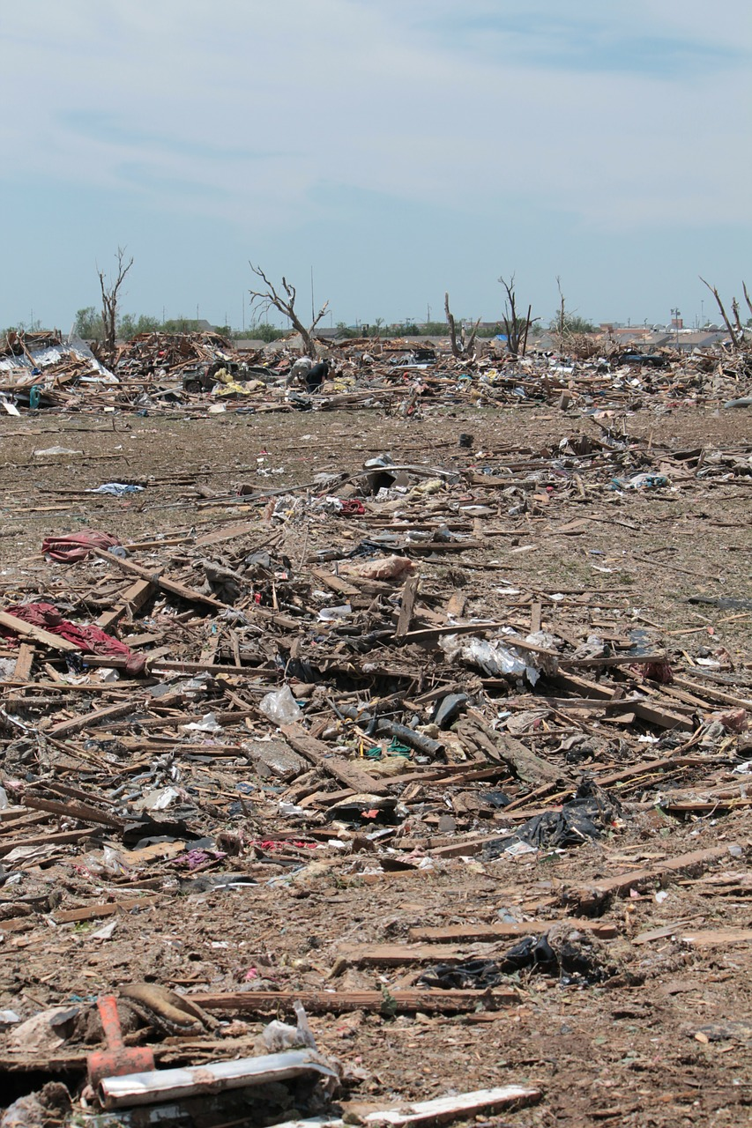

ALL FOR ONE
Make a change
Make a change
Make a change

Slide 2


Slide 3

Make a change
Make others change
Change the world

Slide 4
Make a change
Make others change
Change the world

Slide 5
ALL
FOR
ONE

